Slide 1
Predicting Pitcher Injury
Roger Chow (r6chow)

Slide 2
Problem
Injuries in Major League Baseball are costly and on the rise, particularly injuries among pitchers.
In 2015, injured players placed on the disabled list cost $700 million in player salaries. Pitchers accounted for more than 50% of the disabled list.¹
A pitcher on the disabled list may cut a team’s odds of winning the season. Cleveland Indians was first place going into 2016 postseason but having two starting pitchers on the disabled list may have cost them the World Series championship.
OBJECTIVE: Develop a regression model to predict pitcher injury for the next baseball season using pitching movement stats.
https://www.forbes.com/sites/maurybrown/2015/10/16/infographic-breaks-down-where-700-million-in-baseball-injuries-are-at/#6a7fafd211ce

Slide 3
Dataset
PitchFX
The PitchFX is a system tracks pitch-by-pitch detail of every pitch thrown in every game placed for 2010 to 2016. The high level attributes include:
Acceleration
Velocity
Movement
Release point
Spin
Pitch Type
The data is provided in multiple XML format broken down by year, month, day, game and inning (http://gd2.mlb.com/components/game/mlb/).
Disabled List
The Disabled List (http://www.baseballheatmaps.com/disabled-list-data/) dataset in separate CSV files for individual years spanning 2010 to 2016. Each file provides the following information:
Player
DL Date
Days on DL

Slide 4
Approach
Scrape PitchF/X to database
Exploratory Analysis and Outlier Detection
Multivariate Logistic Regression and Evaluation
Load data from database to R and Impute
Predictions for 2017
Label the data
Transform

Slide 5
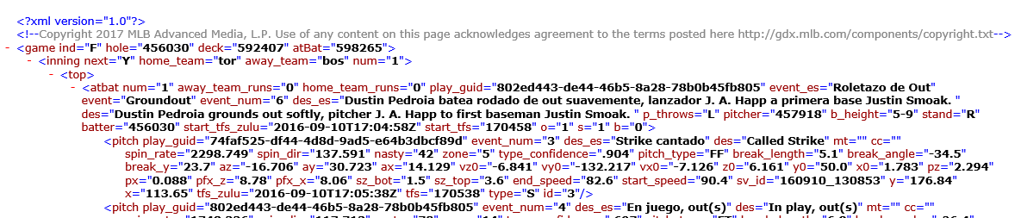
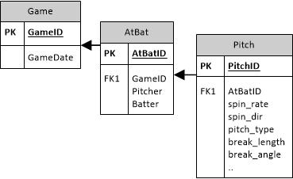
Scrape data to database
PitchFX XML (sample of one pitch in one game)
PitchFX Database
.NET Application

Slide 6
Load data to R
PitchFX Database
R
query <-
paste("SELECT", i, " as season, m.rsID, p.id, p.atbatid, a.pitcher,
p.x, p.y, p.start_speed, p.end_speed, p.sz_top, p.sz_bot,
p.px, p.pz, p.x0, p.y0, p.z0, p.vx0, p.vy0, p.vz0, p.ax, p.ay, p.az,
p.break_y, p.break_length, p.spin_dir, p.spin_rate,
1 as type_ALL,
…
CASE WHEN ISNULL(p.pitch_type,'UN') = 'SI' THEN 1 ELSE 0 END AS type_SI,
CASE WHEN ISNULL(p.pitch_type,'UN') = 'SL' THEN 1 ELSE 0 END AS type_SL,
CASE WHEN ISNULL(p.pitch_type,'UN') not in ('AS', 'CH', 'CU', 'EP', 'FA', 'FC', 'FF', 'FO', 'FS', 'FT', 'IN', 'KC', 'KN', 'PO', 'SC', 'SI') THEN 1 ELSE 0 END as type_UN
FROM [PitchFx",i,"].[dbo].[Pitches] p
INNER JOIN [PitchFx",i,"].[dbo].[AtBats] a on a.ID = p.AtBatID
INNER JOIN [Mapping].[dbo].[RSID_MLBID_MAP] m on a.pitcher = m.mlbid
INNER JOIN [Lahman].[dbo].[Master] ms on ms.retroID = m.rsID", sep="");
pitches_raw <-sqlQuery(dbhandle, query);
pitches_impute_centroid <- ddply(pitches_raw, ~rsID, transform,
x = impute(x, impute_fun),
y = impute(y, impute_fun),
start_speed = impute(start_speed, impute_fun),
…
break_y = impute(break_y, impute_fun),
break_length = impute(break_length, impute_fun),
spin_dir = impute(spin_dir, impute_fun),
spin_rate = impute(spin_rate, impute_fun)
);
Impute missing values with median

Slide 7
Label Data
A response variable OnDL is added and defined to be 1 if the pitcher is was on the disabled list or 0 otherwise.
#use previous season to predict DL in current season pitches_dl <- merge(x=pitches, y=dl, by.x=c("rsID", "season"),
by.y=c("rsid", "season_1"), all.x = TRUE, all.y=FALSE) pitches_dl[pitches_dl==""] <- NA; #replace blanks with NA pitches_dl$DLDays[is.na(pitches_dl$DLDays)] <- 0; pitches_dl$OnDL <- (ifelse(pitches_dl$DLDays>0, 1, 0));
There are 10 pitchers on disabled list who are not recorded on PitchFX

Slide 8
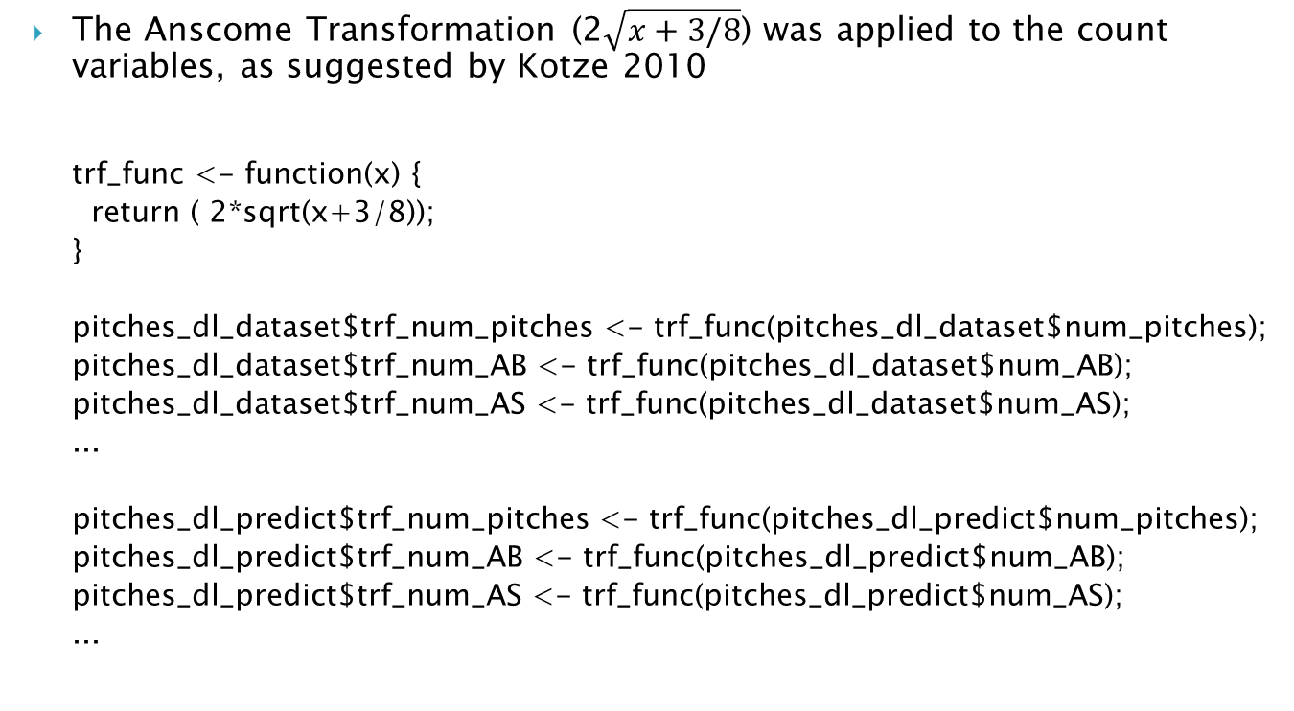
Transform Count Data
The Anscome Transformation (2$\sqrt{x+3/8}$) was applied to the count variables, as suggested by Kotze 2010
trf_func <- function(x) {
return ( 2*sqrt(x+3/8));
}
pitches_dl_dataset$trf_num_pitches <- trf_func(pitches_dl_dataset$num_pitches);
pitches_dl_dataset$trf_num_AB <- trf_func(pitches_dl_dataset$num_AB);
pitches_dl_dataset$trf_num_AS <- trf_func(pitches_dl_dataset$num_AS);
...
pitches_dl_predict$trf_num_pitches <- trf_func(pitches_dl_predict$num_pitches);
pitches_dl_predict$trf_num_AB <- trf_func(pitches_dl_predict$num_AB);
pitches_dl_predict$trf_num_AS <- trf_func(pitches_dl_predict$num_AS);
...

Slide 9
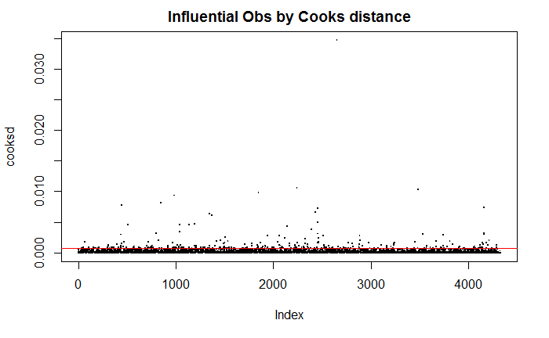
Exploratory Analysis and Outlier Detection
The data set used for modeling consisted of 4,327 observations after aggregating the 5,467,439 pitching events downloaded from the MLB website for the years 2010 to 2016 with 40 variables (including counts of pitch types)
Use Cook’s Distance to identify potential outliers. (236 outliers)

Slide 10
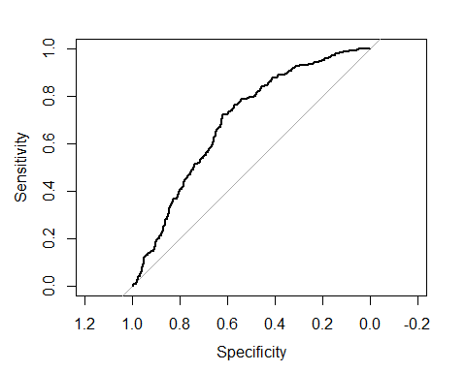
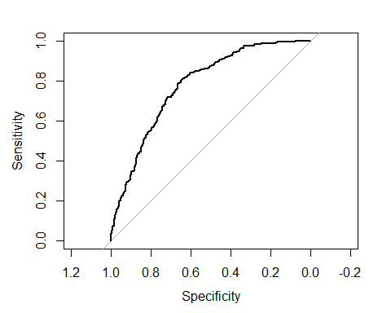
Logistic Regression
Model # | Description | # variables | Confusion Matrix and accuracy | ROC
1 | All data with outliers | 39 | ## Reference ## Prediction 0 1 ## 0 673 244 ## 1 85 79 ## ## Accuracy : 0.6957 ## Sensitivity : 0.24458 ## Specificity : 0.88786 ## AUC : 0.690
1b | All data without outliers | 39 | ## Prediction 0 1 ## 0 678 174 ## 1 97 87 ## ## Accuracy : 0.7427 ## Sensitivity : 0.33333 ## Specificity : 0.88166 ## AUC : 0.738

Slide 11
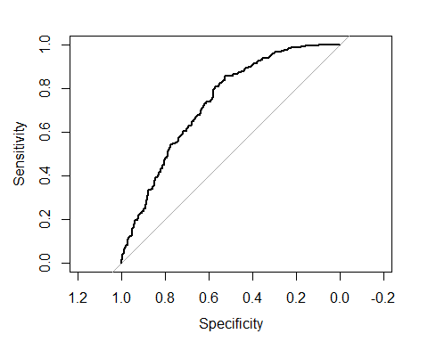
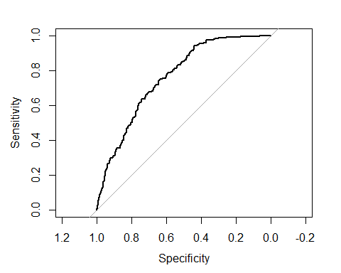
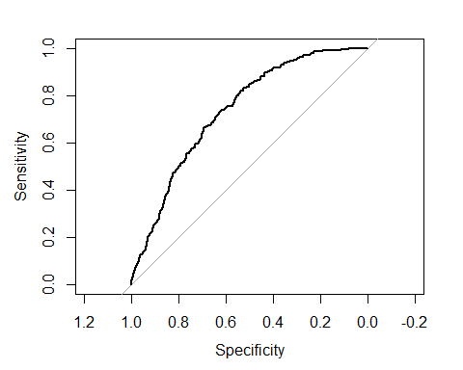
Logistic Regression (cont.)
Model # | Description | # variables | Confusion Matrix and accuracy | ROC
2 | Correlations cutoff = 0.25 | 17 | ## Reference ## Prediction 0 1 ## 0 688 196 ## 1 81 65 ## ## Accuracy : 0.7311 ## Sensitivity : 0.24904 ## Specificity : 0.89467 ## AUC : 0.734
2b | Correlations cutoff = 0.50 | 24 | ## Reference ## Prediction 0 1 ## 0 688 184 ## 1 81 77 ## ## Accuracy : 0.7427 ## Sensitivity : 0.29502 ## Specificity : 0.89467 ## AUC : 0.735
2c | Correlations cutoff = 0.75 | 29 | ## Reference ## Prediction 0 1 ## 0 680 189 ## 1 89 72 ## ## Accuracy : 0.7301 ## Sensitivity : 0.2759 ## Specificity : 0.8843 ## AUC : 0.736

Slide 12
Predictions for 2017
Significant Variables
px – left/right distance from the middle plate as it crosses home plate
pz – height of the pitch as it crosses home plate
z0 – height of the pitch at the initial point
ay – acceleration in the y axis
num_FA - number of fastball
num_FF – number of four seam fastball
num_FT – number of two seam fastball
num_IN – number of intentional ball
num_SI – number of sinker

Slide 13
Predictions for 2017
Top 10 pitchers with highest probability of injury
J. A. Happ
Kevin Gausman
Aaron Sanchez
Jake Odorizzi (On DL as of April 15, 2017) ¹
Ricky Nolasco
Robbie Ray
Jose Quintana
Ubaldo Jimenez
Jon Lester
Martin Perez
http://mlb.mlb.com/mlb/fantasy/injuries/

